Slide 1
SPRING BOOT
AMJIYAD AHSAN K S
MCA

Slide 2
SPRING BOOT
Spring Boot is an open source Java-based framework used to create a micro Service
Spring makes programming Java quicker, easier, and safer for everybody.
Spring’s focus on speed, simplicity, and productivity has made it the world's most popular Java framework.

Slide 3
Microservices
Microservices are a modern approach to software whereby application code is delivered in small, manageable pieces, independent of others.
Micro services offers the following advantages to its developers :
Easy deployment
Simple scalability
Compatible with Containers
Minimum configuration
Lesser production time

Slide 4
FEATURES OF SPRING BOOT
Spring is flexible
Spring is productive
Spring is fast
Spring is secure

Slide 5
“Hello world” program
Step 1: Start a new Spring Boot project:
Use start.spring.io to create a “web” project. In the “Dependencies” dialog search for and add the “web” dependency.
Hit the “Generate” button, download the zip, and unpack it into a folder on your computer.

Slide 6
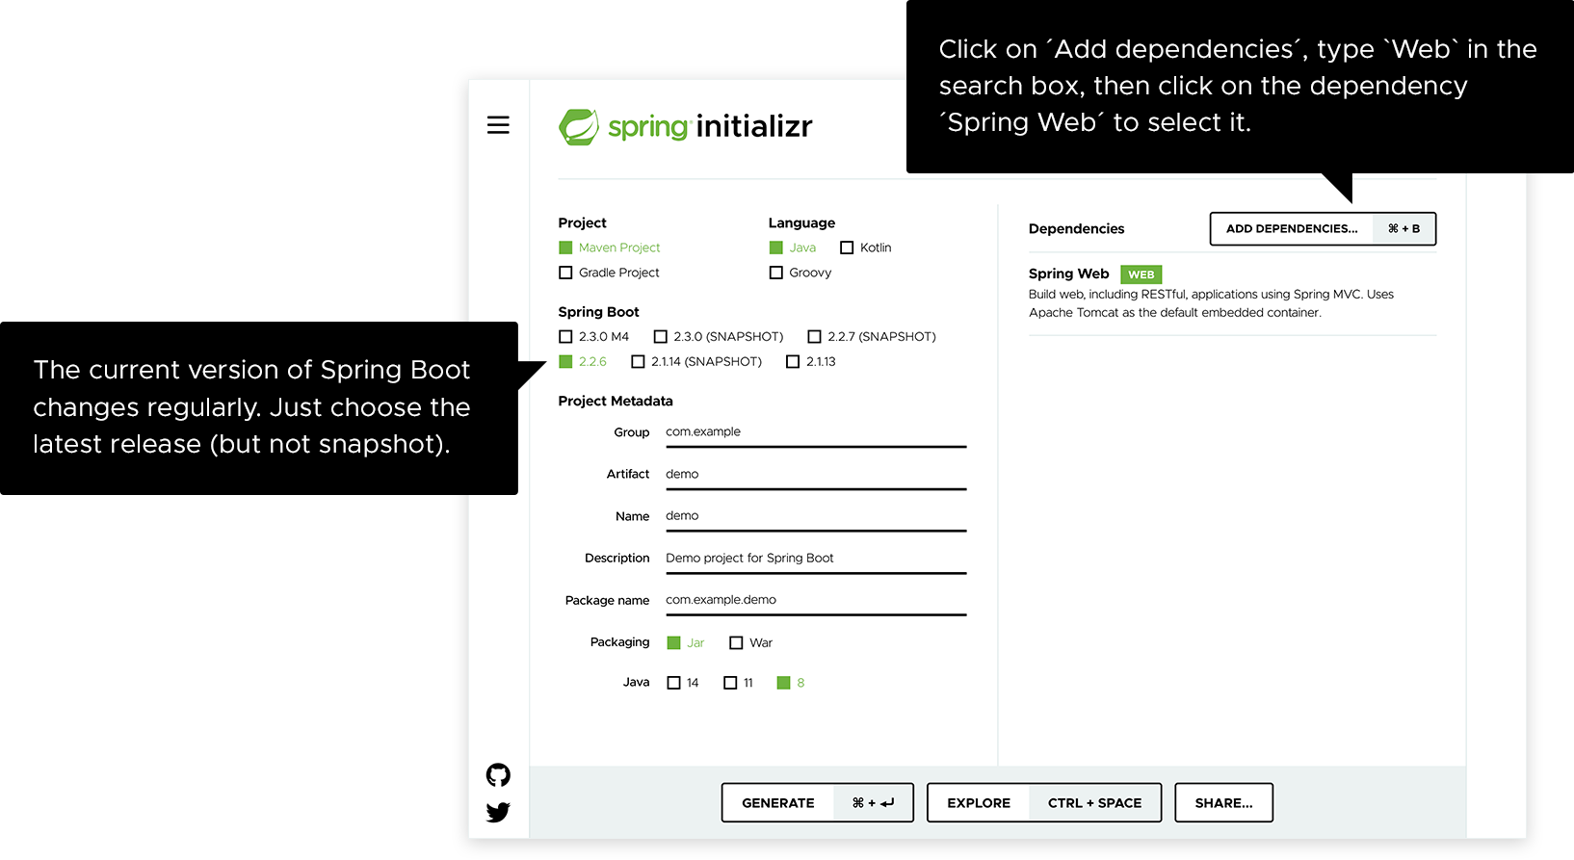

Slide 7
Projects created by start.spring.io contain Spring Boot, a framework that makes Spring ready to work inside your app, but without much code or configuration required.
Step 2: Add your code
Open up the project in your IDE and locate the ‘DemoApplication.java’ file. Now change the contents of the file by adding the extra method and annotations.

Slide 8
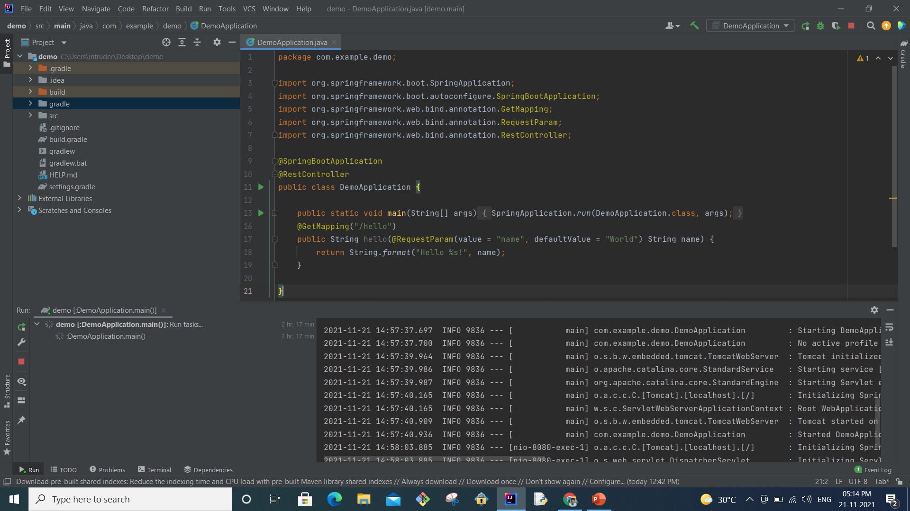

Slide 9
Step 3: Run the program
Spring Boot’s embedded Apache Tomcat server is acting as a webserver and is listening for requests on localhost port 8080. Open your browser and in the address bar at the top enter http://localhost:8080/hello

Slide 10


Slide 11
THANK YOU

